Slide 1
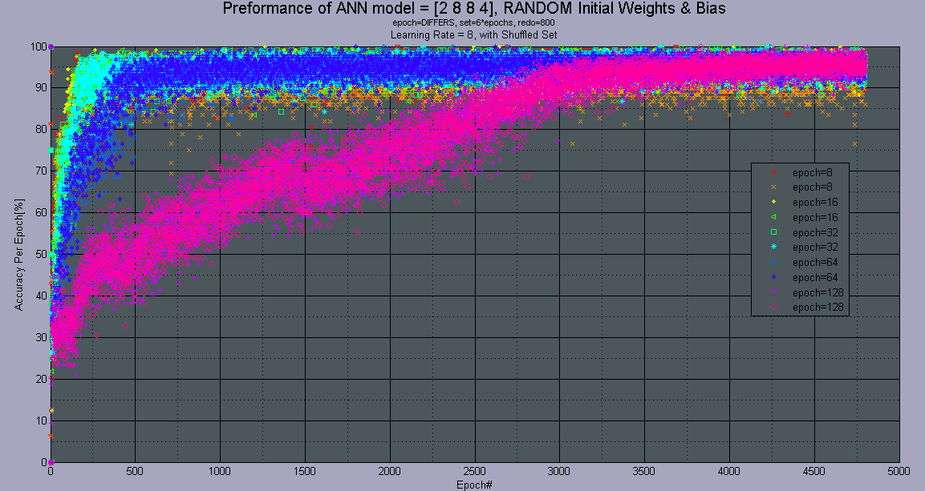
Maxeler Platform Artificial Neural Network

Slide 2
1. Revision History
date | by | main change
15/9/2016 | dogev | creation
Notes:
Remember to add dates after first draft is finalized…

Slide 3
2. Presentation Outline
Motivation
Goal
Design Overview
Problems Encountered
Hardware Architecture
Software Architecture
Results
Degrees of Freedom
What's Next
FAQs
Questions

Slide 4
Motivation: Optimal Implementation of ANN
ANN are becoming more and more popular in un-linear solution approximation
New Available Massive Parallelism Technology
Reaching far faster training time via Parallel Hardware… like a human brain
Dynamically Self Organizing Optimal Topology
Cascading Multiple ANN

Slide 5
Goal
Parallel Data Flow Engines ANN in Hardware
Creating a Generic Building Block for AI architectures
Supporting Pre\Post data analysis or feature extractions
different activation functions
Generic AI API
Loading and Exporting AI parameters for different tasks
Controlling Database partition and Epoch sizes
CPU Controller oversees training and outputting
C++ Host Code calls the ANN
Comprehensive Statistical Learning Report

Slide 6
Design Overview: Tasks Division
CPU
API
Database management
DFE configuration for ANN
Batch Update Weights
Calculated Statistical Errors
Maxeler DFE
Feedforward Parallel Data Stream Engine
Backpropagation

Slide 7
Design Overview: Top

Slide 8
Problems Encountered
Lacking Theoretical background
Unquantifiable Maxeler Hardware bit sizes
Avoiding data dependency loops in a stream DFE
Optimal Runtime Back Propagation while streaming new data
Mathematical analysis and theorem for new BP
Pipeline and Hardware optimal utilization
Unknown Syntax issues
No Google
Kernel.Math(exp) float mismatch in DFE vs Sim

Slide 9
Hardware Architecture

Slide 10
Hardware Architecture: inner

Slide 11
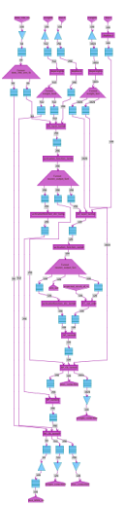
Hardware Architecture: Manager

Slide 12
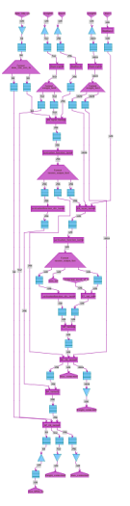
Hardware Architecture: FF Kernels

Slide 13
Hardware Architecture: BP Kernels

Slide 14
Software Architecture: Input Database

Slide 15
Software Architecture: Input Database
Open csv database
Randomly shuffle the database
Split database per epoch to:
Training – learning set
Generalization – statistical analysis
Validation – final performance test

Slide 16
Software Architecture: Input Algorithm Params

Slide 17
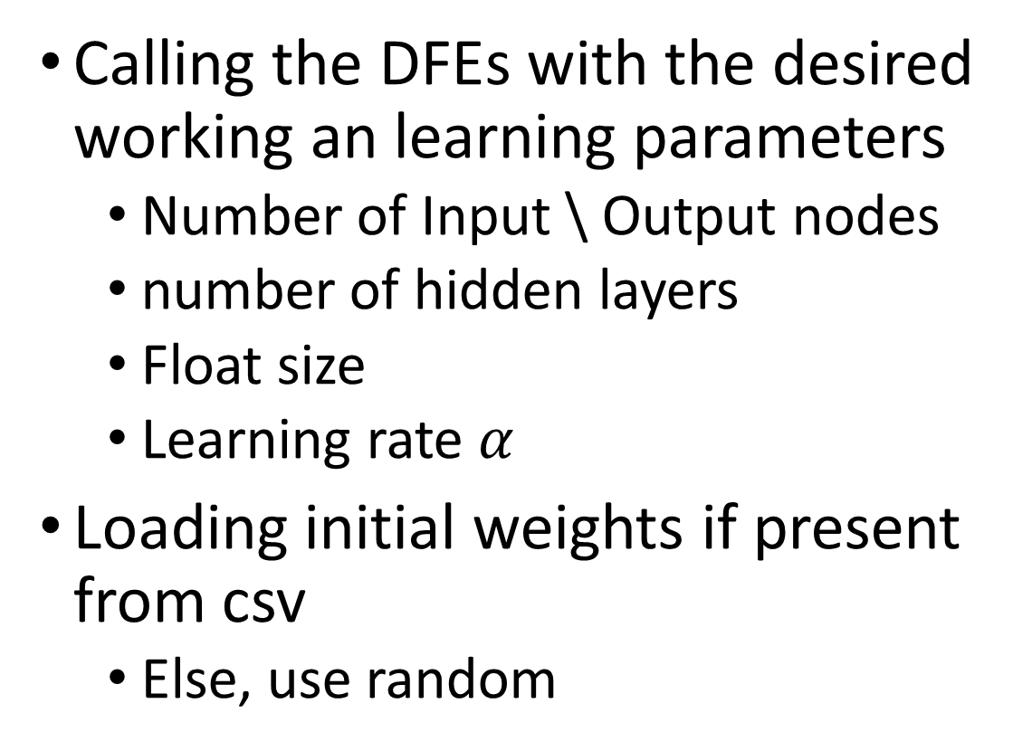
Software Architecture: Input Algorithm Params
Calling the DFEs with the desired working an learning parameters
Number of Input \ Output nodes
number of hidden layers
Float size
Learning rate $α$
Loading initial weights if present from csv
Else, use random

Slide 18
Software Architecture: Write BP new Weights

Slide 19
Software Architecture: Write BP new Weights
Per Batch\Epoch:
Gets weights corrections from the DFE Back Propagation algorithm
Normalize the average correction over entire batch
In order to make sure each data entry has the same effect over weight calculation
The memory can only be written by the CPU in our flow-control
Run a generalization set for statistical analysis

Slide 20
Software Architecture: Save Topology & LOGs

Slide 21
Software Architecture: Save Topology & LOGs
check (performance or number of iterations)
After stop condition is met
Export report and final NN layout
Run final validation set to estimate NN performance

Slide 22
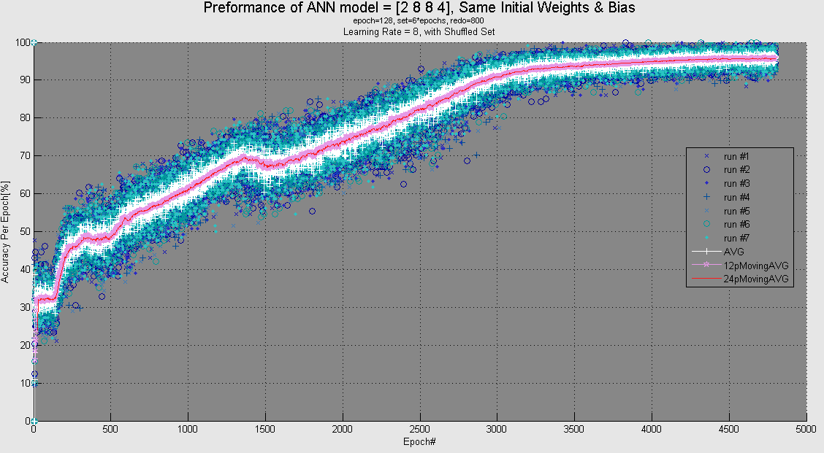
Results Against Golden Modules

Slide 23
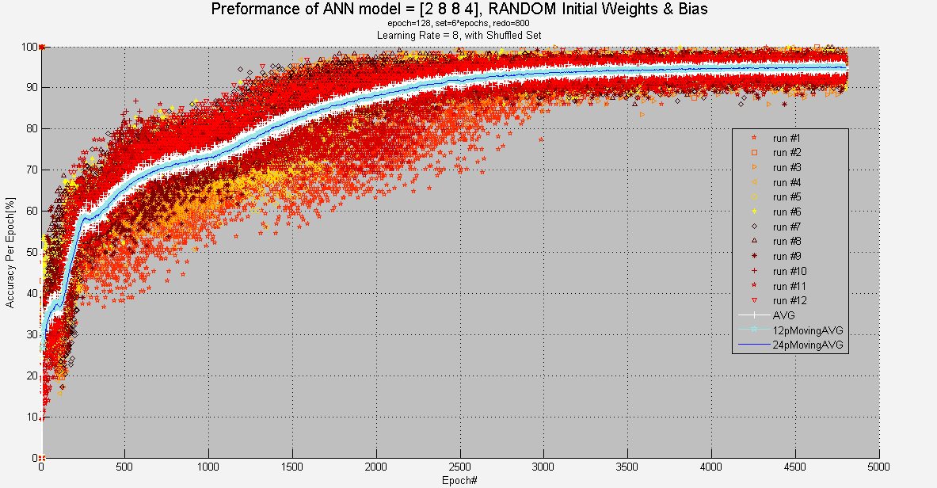
Results Against Golden Modules

Slide 24
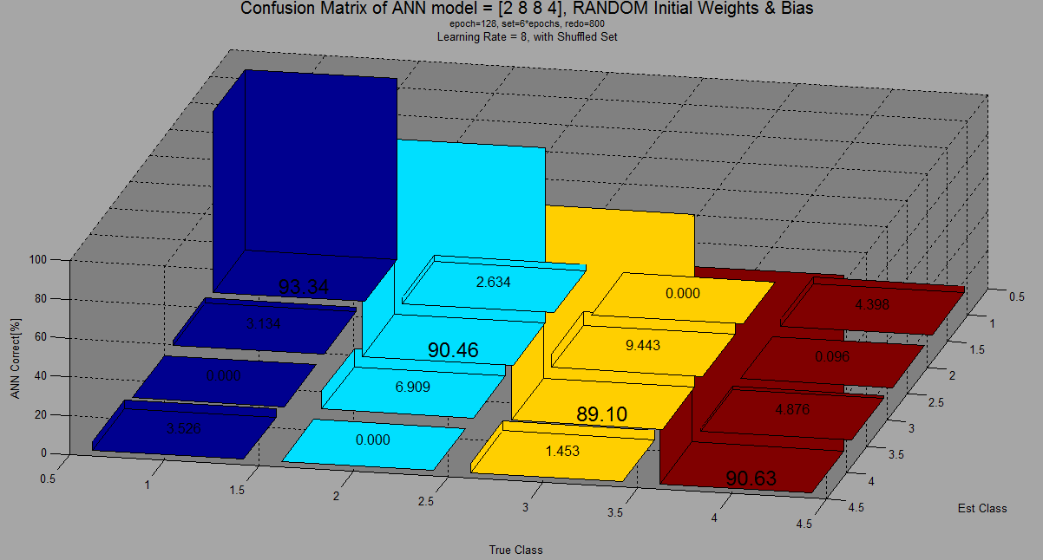
Results Against Golden Modules

Slide 25
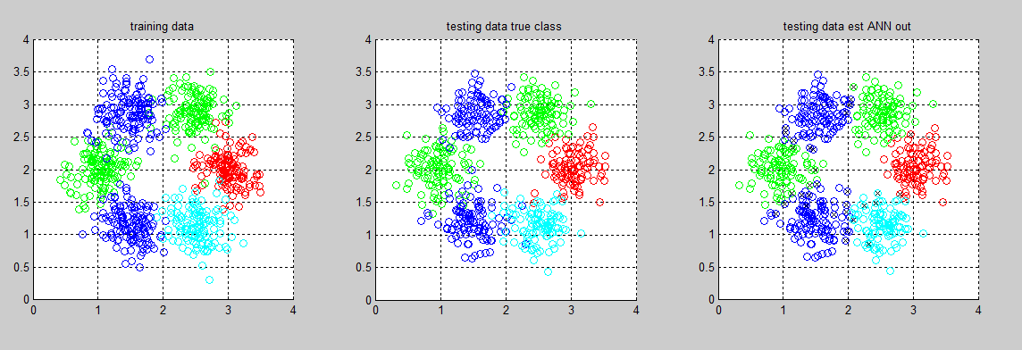
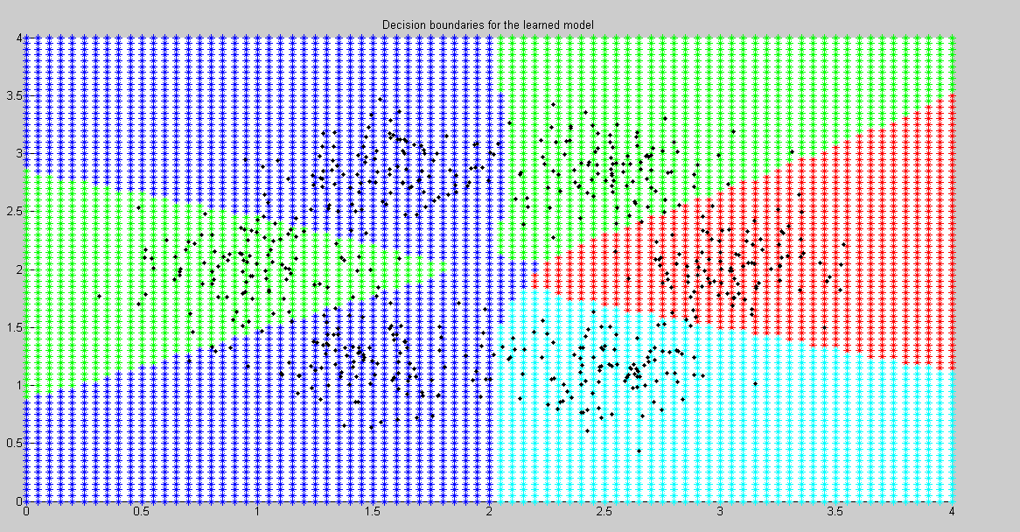
Results Against Golden Modules Classifier

Slide 26
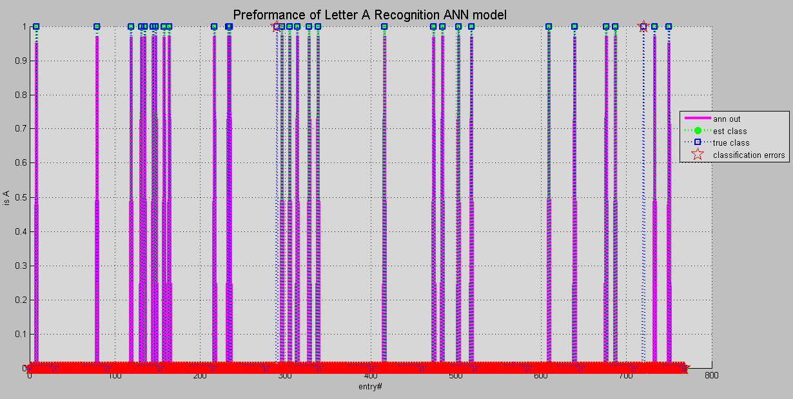
Results MINST Letter A Recognition

Slide 27
Resource Utilization per topology
ANN = [2 8 4] RESOURCE USAGE
Logic utilization: 195599 / 297600 (65.73%)
LUTs: 140452 / 297600 (47.19%)
Primary FFs: 187653 / 297600 (63.06%)
Multipliers (25x18): 444 / 2016 (22.02%)
DSP blocks: 444 / 2016 (22.02%)
Block memory (BRAM18): 377 / 2128 (17.72%)
ANN = [2 8 8 4] RESOURCE USAGE
Logic utilization: 388378 / 297600 (130.50%)
LUTs: 281913 / 297600 (94.73%)
Primary FFs: 377632 / 297600 (126.89%)
Multipliers (25x18): 932 / 2016 (46.23%)
DSP blocks: 932 / 2016 (46.23%)
Block memory (BRAM18): 718 / 2128 (33.74%)

Slide 28
Timing Compare
A fully connected ANN had been made into a working DFE!
Timing performances vs GPUs is now tested…
So the final result it yet to be posted

Slide 29
Degrees of Freedom
Number of layers , inputs and outputs
Database partition and Epoch size
Learning rate
Activation Function
Initial Weights

Slide 30
What’s Next
Push our building block to the wide use APP
Non Blocking Handler
S.O.O – Self Organizing Optimization
MaxRinging a lot of ANNs
Python Generated envelop

Slide 31
Thank You!!!

Slide 32
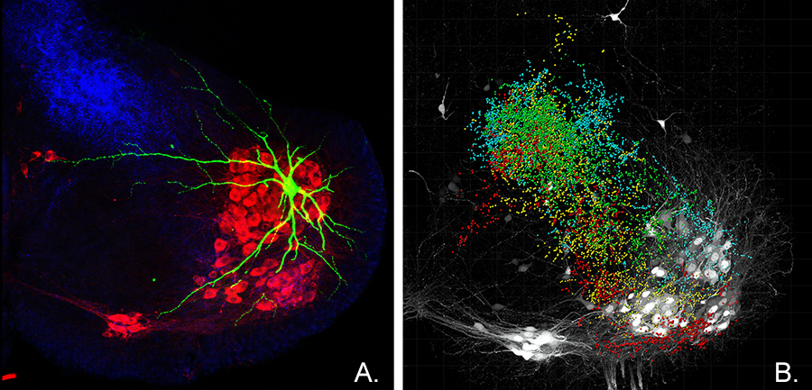
FAQ: What is Artificial Neural Network
What kind of AI
Advantages
Basic structure

Slide 33
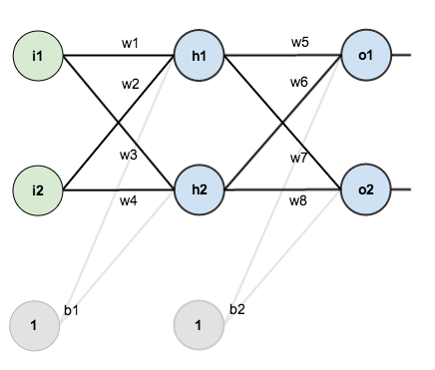
FAQ: Basic Artificial Neural Network
Topology and connection
Basic data flow

Slide 34
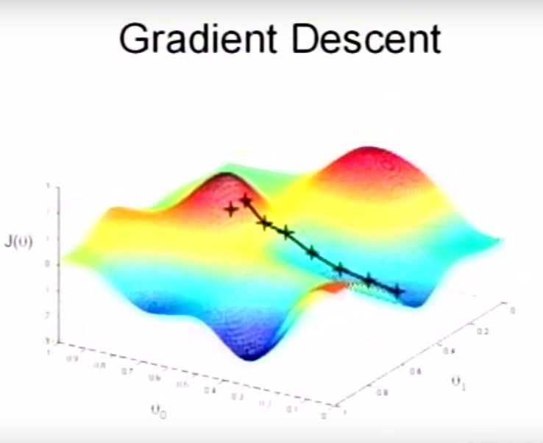
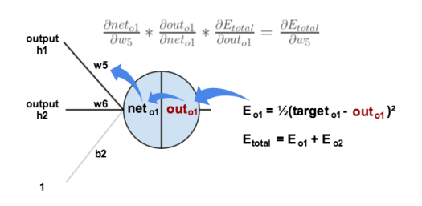
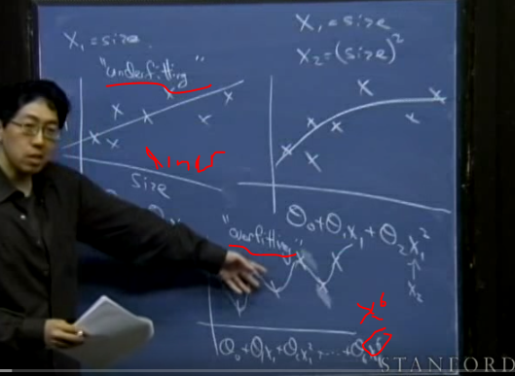
FAQ: Basic Learning Process
BP
Gradient Decent

Slide 35
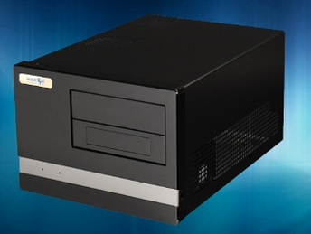
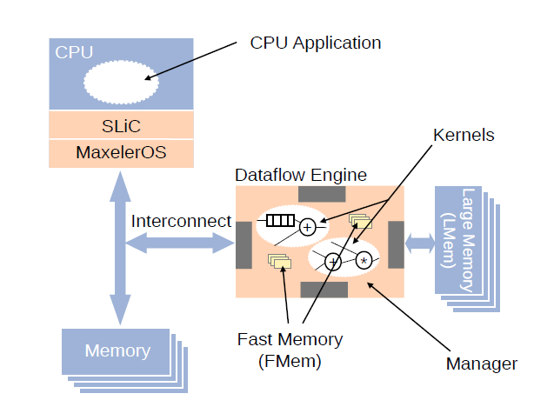
FAQ: What is the Maxeler Platform and DFE
Data stream flow engines computing
The different parts of the platform
Design Flow
Advantages

Slide 36
Questions

